Slide 1


Defender for Cloud
Luke Murray

Slide 2
Understanding Defender for Cloud
KEEP
CALM
AND
SECURE IT IN AZURE

Slide 3



Attackers choose the path of least cost/resistance
Antipattern: Believing attackers will follow the planned path
Defenders must focus on
Strong security controls + effective placement
Rapid response to attacks
Continuously testing & monitoring controls

Slide 4
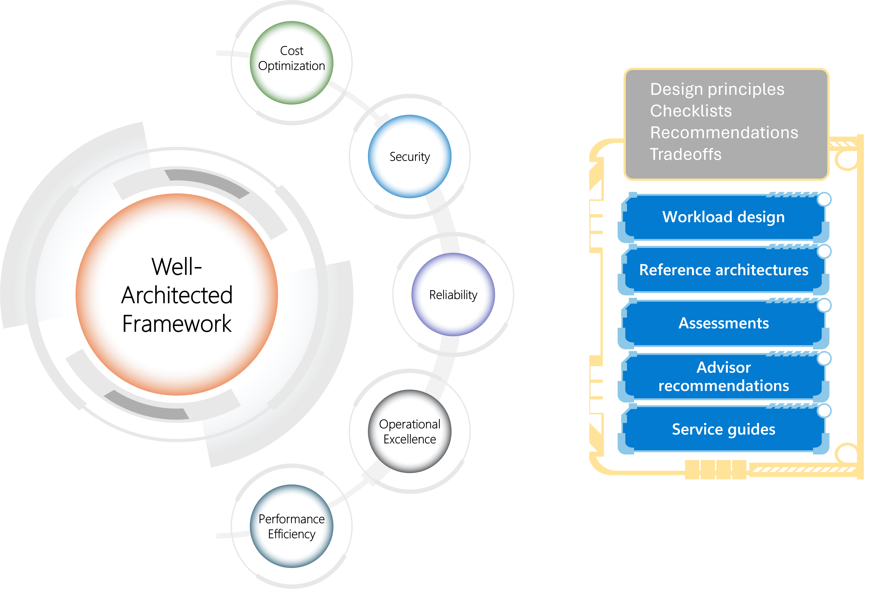

Slide 5





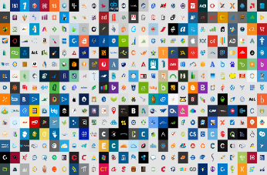



















Microsoft Zero Trust Capability Mapping
Key
Security Analytics
NIST Area
NIST Sub-Area
Sub-Area
Microsoft Sentinel
Microsoft Defender XDR
Security Information and Event Management (SIEM)
Security Orchestration, Automation, and Response (SOAR)
Microsoft Service
Defender for Endpoint
Defender for Office 365
Defender for Identity
Defender for Cloud Apps
Defender for Cloud
Security telemetry from across the environment
Endpoint Security
ICAM
PE/PA
Protected Resources
Identity, Credentials, and Access Management (ICAM)
Policy Enforcement / Admin (PE/PA)
Microsoft Entra
Conditional Access
Global Secure Access client
Policy
Determine Access
CLOUD APPS & WORKLOADS
Identity
User
Device
Access & Credential Mgmt.
Authentication
Authorization
Defender for Cloud Apps
3P SaaS
User
Defender for Office 365
PEP
Cloud Apps
Workloads
Entra ID
Microsoft 365
Intune
Device Management
Grant Access
Conditional Access
Entra Permissions Management
Entra ID
Devices
Entra ID Governance
Defender for Cloud
Grant Access Software Defined Perimeter(SDP)
Entra Internet Access
Microsoft Cloud Security Benchmark
Azure IaaS
Federation
Governance
Policy Enforcement Point (PEP)
ON-PREM APPS & WORKLOADS
Mobile Device
Database
File share
Storage
Data
Purview
Azure Arc
Information Protection Scanner
Defender for Endpoint
Endpoint Detection and Response (EDR)
Secure Admin Workstations
Feedback mechanisms enable continuous improvement
Apps
Defender Application Guard
Virtual Desktops
Entra
Azure Virtual Desktop
Entra Private Access
Connector
Infrastructure & Access
Azure Arc
Devices w/ SDP
Intune
Defender for Identity
Azure Automanage
Intune
Windows 365
VPN Backend Connector
Data Security
Data Loss Prevention (DLP)
Purview
Document Protection
Purview
Office 365
Intune
Defender for Cloud Apps
Purview
Cloud Infra SQL DB/Files
Defender for Cloud
DLP
Information Protection
Mobile App Mgmt
Information Protection

Slide 6
“Microsoft Defender for Cloud is a cloud-native application protection platform (CNAPP) that is made up of security measures and practices that are designed to protect cloud-based applications from various cyber threats and vulnerabilities.”

Slide 7
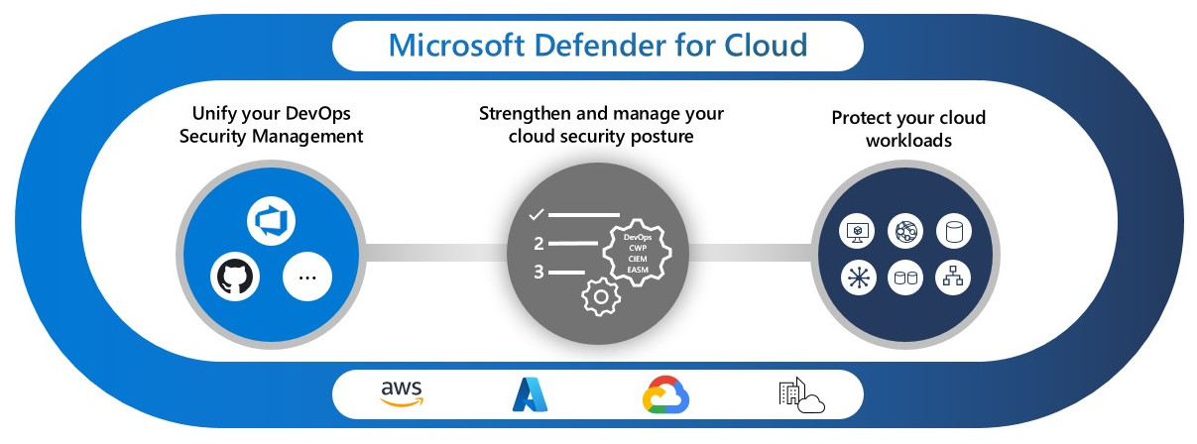

Slide 8
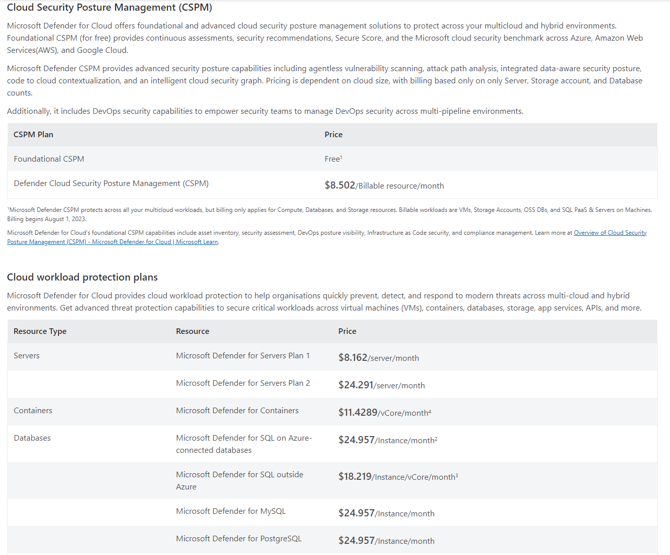
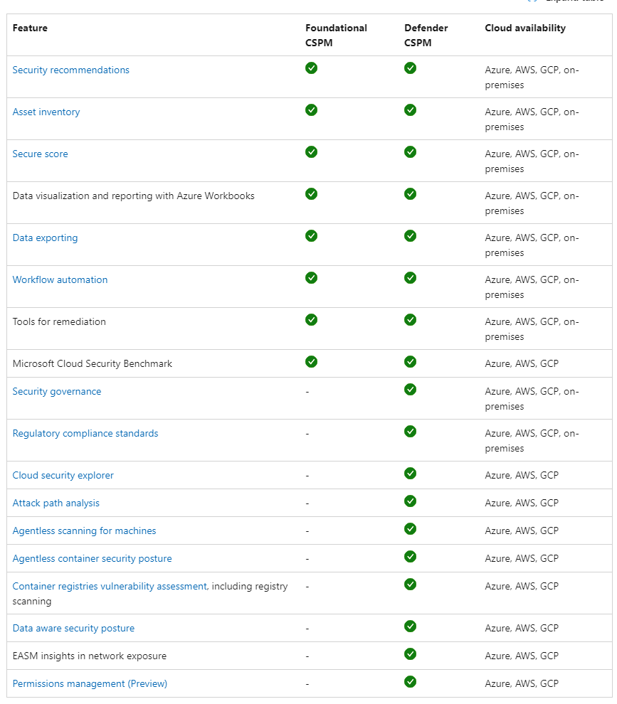

Slide 9

PRAY
TO
THE
DEMO

